Slide 1
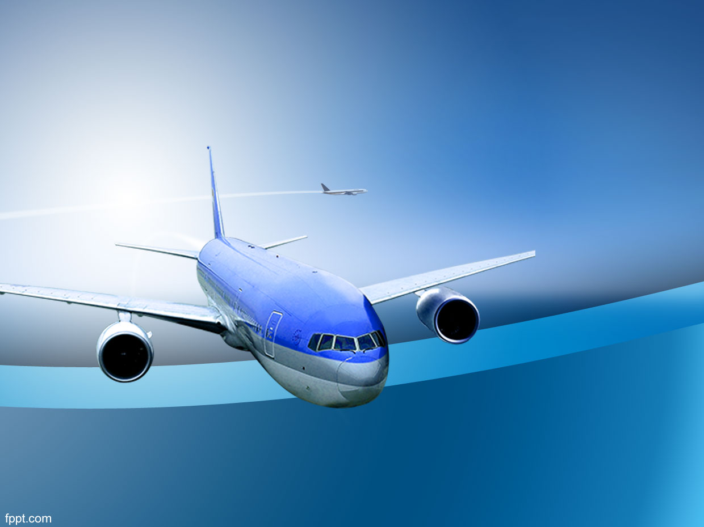
Can you detect my aircraft?
Leo Liu, MS

Slide 2
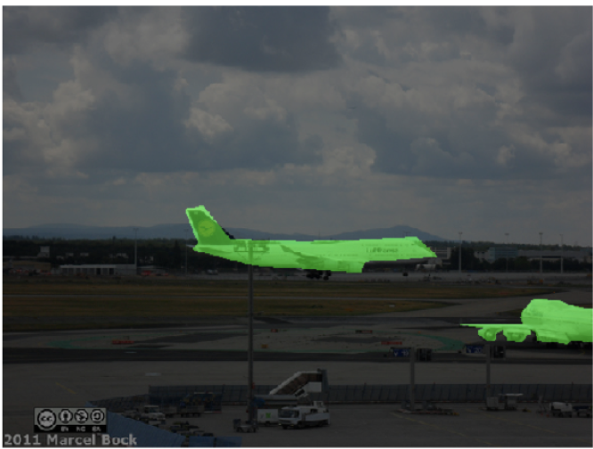

Motivation
Enhance aviation safety
Improve ground traffic efficiency
Notes:
A near-miss incident happened in Shanghai in 2016. An aircraft taxied across a runway that another aircraft was taking off from. The two aircraft nearly collided. This near-miss could have been prevented if the two aircraft had image processing systems that detect other aircraft in their field of view. This is why I decided to build a system to detect aircrafts, which will enhance aviation safety and improve ground efficiency.

Slide 3








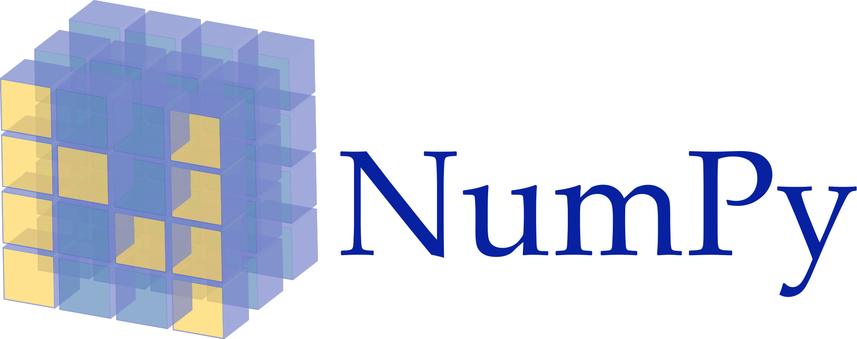

Workflow
Data Collection
Image Preprocessing
Model Construction
Real World Application
Notes:
Data Collection: I downloaded 3,000 aircraft images from MS COCO dataset, and used API on their GitHub to extract the masks.
Image Preprocessing: Used Skimage to preprocess all images, and verified them with Numpy and Matplotlib so that they are ready to be input into my model.
Model Construction: Constructed a U-net model with Keras on top of Tensorflow, and ran it on an aws machine to use the capabilities of GPUs.
Real World Application: Used Opencv and MoviePy to demonstrate my results.

Slide 4
Workflow
Image Preprocessing
Model Construction
Real World Application
Data Collection
Notes:
Data Collection: I downloaded 3,000 aircraft images from MS COCO dataset, and used API on their GitHub to extract the masks.
Image Preprocessing: Used Skimage to preprocess all images, and verified them with Numpy and Matplotlib so that they are ready to be input into my model.
Model Construction: Constructed a U-net model with Keras on top of Tensorflow, and ran it on an aws machine to use the capabilities of GPUs.
Real World Application: Used Open CV to convert segmented masks into bounding boxes by OpenCV and decode the video into frames by MoviePy

Slide 5

Model Architecture
Notes:
My model is a U-shape model taking in images and generating fully segmented images. Basically, it iterates over all images, examines each pixel and decide whether it belongs to an aircraft or not.

Slide 6
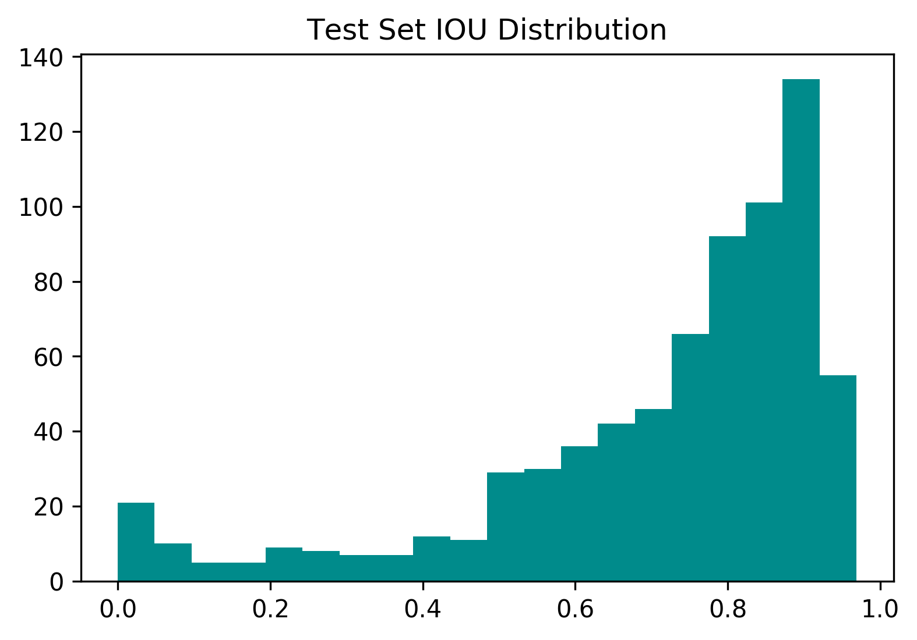
Result
Number of Images
Average IOU
= 0.83
IOU Score of Images
Notes:
Here is the distribution of IOU. The model has an average IOU of 0.83 on test set.

Slide 7
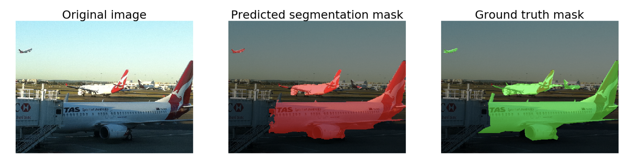
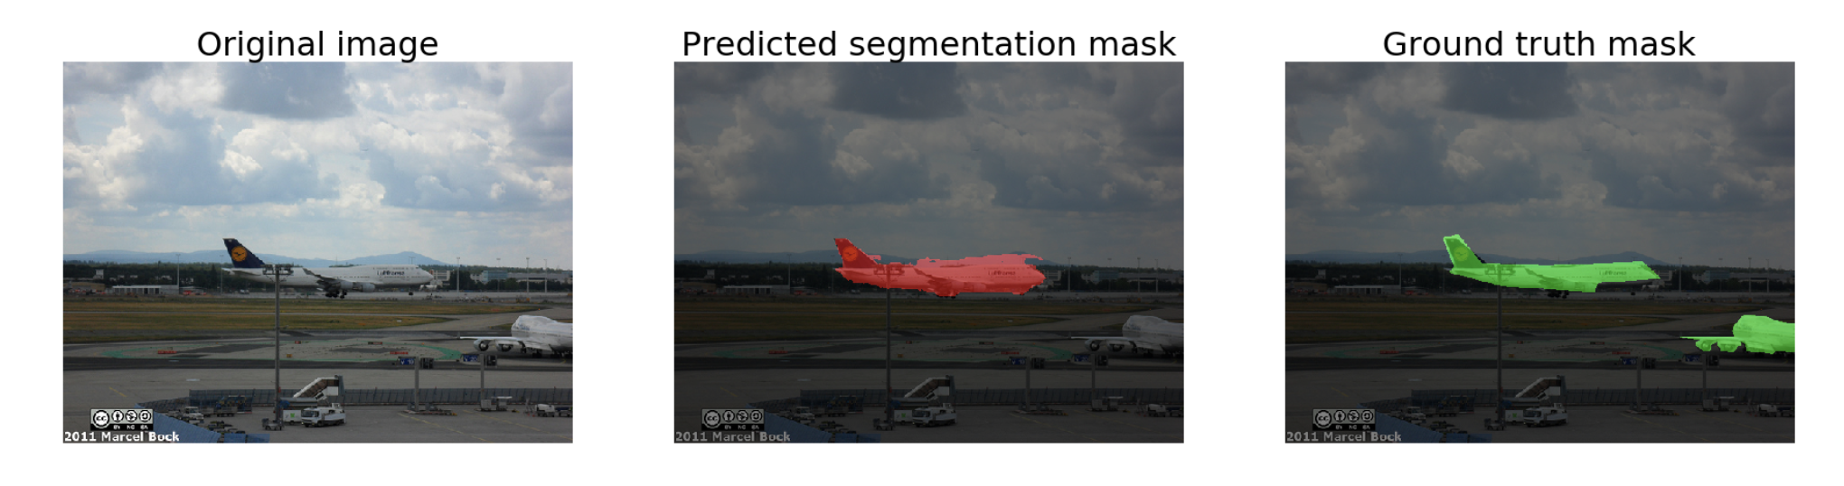
Result
Notes:
Here is one example of my result. Original image on the left, my prediction in the middle and the ground truth on the right. Overall, my model did a great job in detecting aircrafts except for ones in a distance or partially taken into the photo, which require more training data to be correctly identified.
This is great first step of aircraft detection technology that can be put in real production of aircrafts.It has potential of saving lives and increasing ground traffic efficiency.

Slide 8
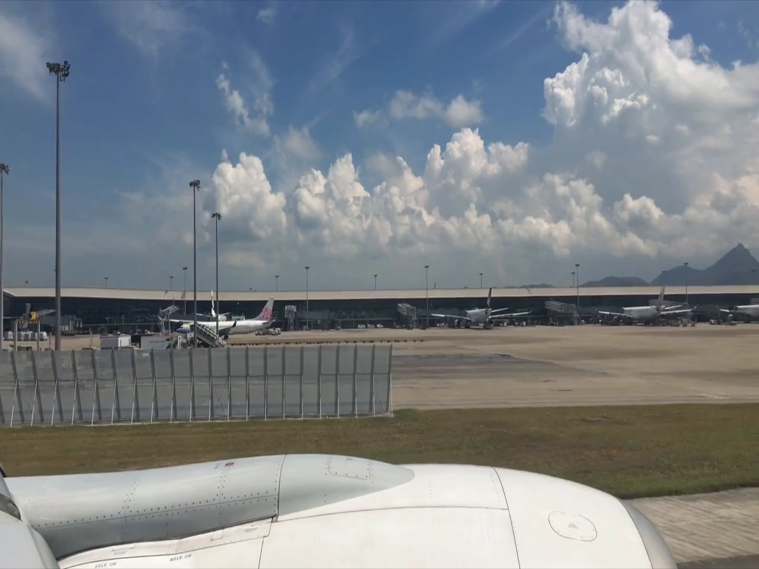
Real-World Application

Slide 9
Future Work
Test in real-time
Train on more relevant data
Augment some challenging images
Transfer learning on other objects

Slide 10




Thank you!
liuriguang@126.com
leoliu2506
Leo’s Data Science Portfolio
leo2506

Slide 11
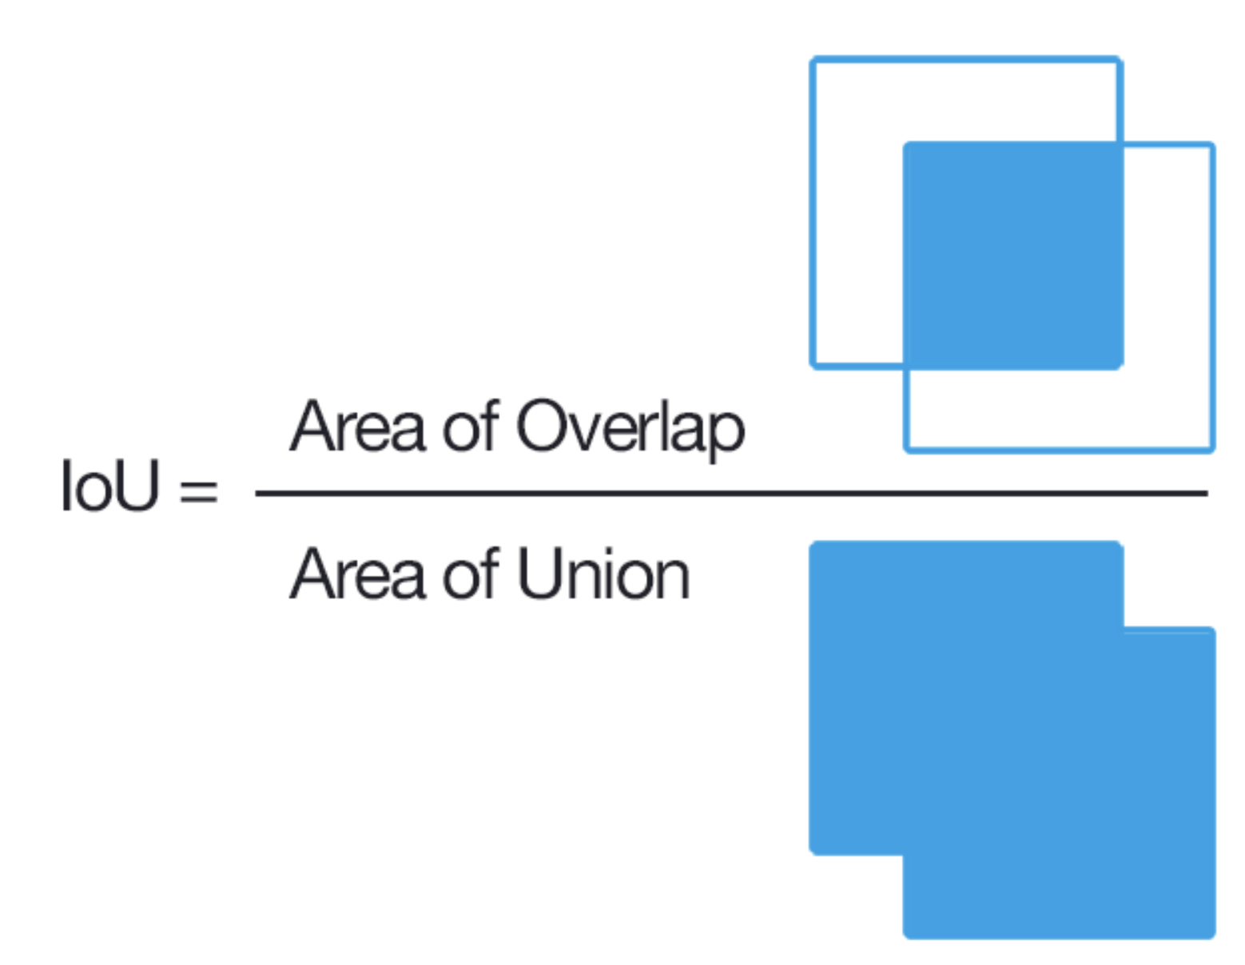
Appendix – IOU

Slide 12
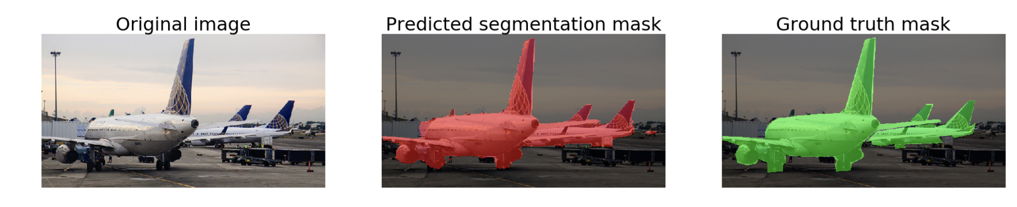
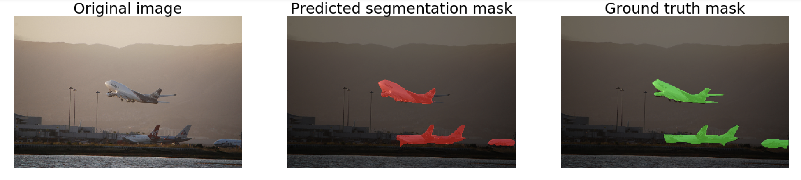
Appendix - Perfect Match

Slide 13
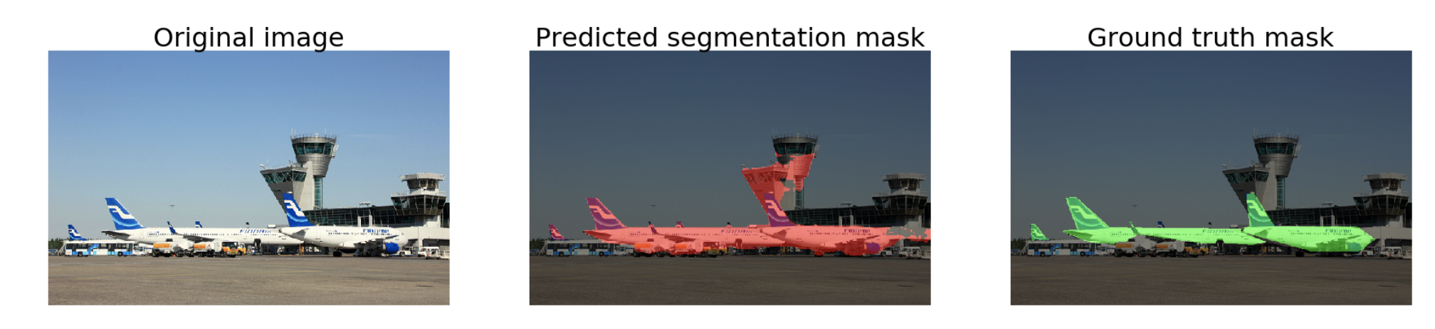
Appendix – False Positive

Slide 14
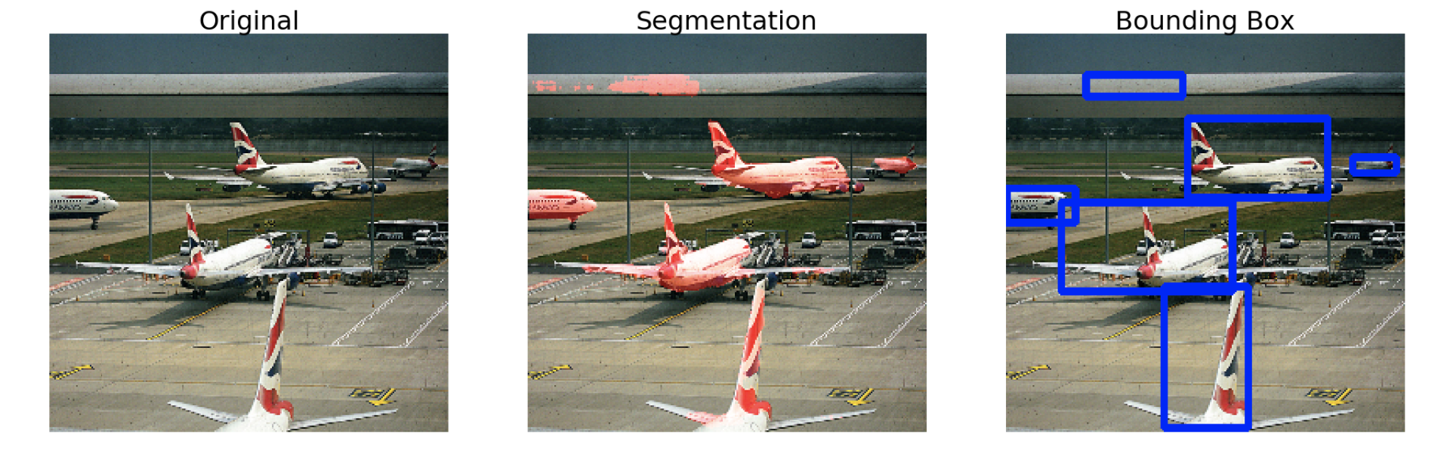
Appendix – Bounding Boxes

